Slide 1

Presentation_ID
© 2001, Cisco Systems, Inc. All rights reserved.

Slide 2
VLSM

Slide 3
Agenda
IP Addressing Review
IP Addressing Crisis & Solutions
Variable-Length Subnet Masks

Slide 4
IP Addressing (IPv4)

Slide 5
IP V4
Addressing using a combination of:
  Network + Host Address
IP Classes:
  A, B, C, D & E
Classful Addressing Scheme
Notes:
The Internet uses this two-level address hierarchy. Rather than calculating and tracking routes to each known host, however, the Internet advertises just the network addresses. End systems that need to access hosts in other networks address their datagrams with the full address, including both network and host numbers, but the routers in the internetwork could assume that the destination network would know how to deliver datagrams to all the end systems within its domain. Therefore, the Internet's routers would only have to track routes to every known network.
A: 0 – 127; B: 128 – 191; C: 192 – 223; D: 224 – 239; E: 240 – 255;

Slide 6
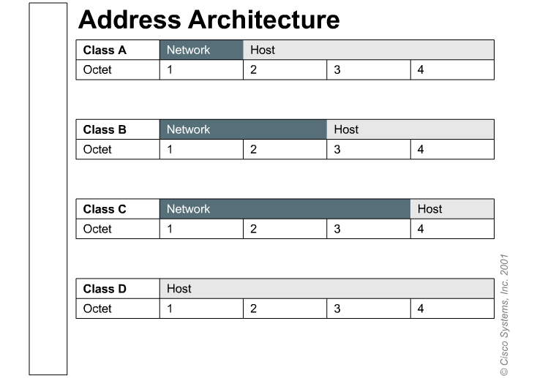
IPv4 = 32 bits divided into 4 octets

Slide 7
IP Addressing Depletion

Slide 8
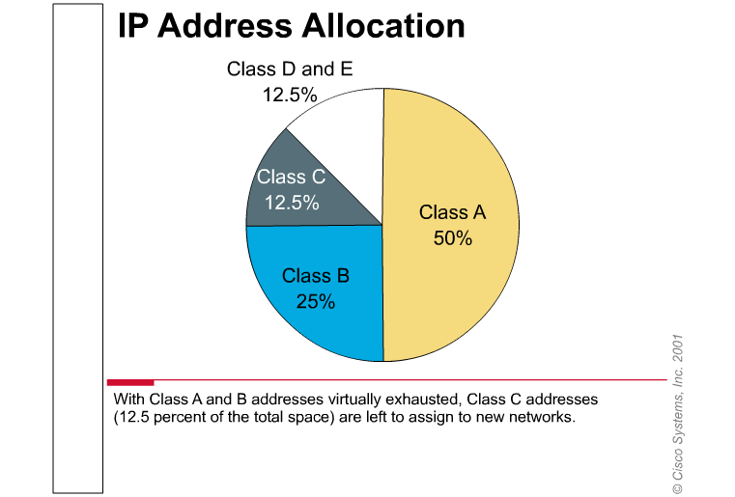
Not enough addresses…?
Notes:
Class A and B addresses make up 75 percent of the IPv4 address space, but a relative handful of organizations (fewer than 17,000) can be assigned a Class A or B network number. Class C network addresses are far more numerous than Class A and Class B addresses, although they account for only 12.5 percent of the possible 4 billion (232) IP hosts, as shown in the Figure. Unfortunately, Class C addresses are limited to 254 hosts, which will not meet the needs of larger organizations that can not acquire a Class A or B address. Even if there were more Class A, B, and C addresses, too many network addresses would cause Internet routers to grind to a halt under the weight of enormous routing tables.

Slide 9
IP Addressing Solutions
Hierarchical Addressing
Subnet masking: RFCs 950, 1812
CIDR: RFCs 1518, 1519, 2050
Private Network Numbers: RFC 1918
Variable-length subnet masks (VLSM): RFC 1812
Network Address Translation : RFC 1631
Notes:
IETF’s major concern was the IP depletion and the size of the routing tables over the internet.
Private Networks were created to reduce the risk of collapsing the internet with duplication of addresses. These addresses do not exist in the Internet and when used in conjunction with NAT (Network Address Translation) will protect the Internet for possible setup errors.
The Private Addresses are:
10.0.0.0 with a subnetmask of 255.0.0.0 . Range from 10.0.0.0 to 10.255.255.255
172.16.0.0 with a subnetmask of 255.240.0.0 . Range from 172.16.0.0 to 172.31.255.255
192.168.0.0 with a subnetmask of 255.255..0.0 . Range from 192.168.0.0 to 192.168.255.255

Slide 10
Classless Inter-Domain Routing
Features:
  The replacement of classful addressing by classless
  Enhanced route aggregation
  Supernetting
Notes:
Routers use a form of IPv4 addressing called classless interdomain routing (CIDR, pronounced "cider") that ignores class.
The replacement of classful addressing with a more flexible and less wasteful classless scheme because it is not set to fixed boundaries.
Enhanced route aggregation, also known as supernetting = grouping of several “Class C” addresses to form a “Class B” or upper class. Opposite to Subneting.

Slide 11
Variable Length Subnet Masks

Slide 12
VLSM
Advantages:
  Efficient use of IP addresses
  Better route summarization
Protocols:
  RIP2
  OSPF
  EIGRP
  BGP v4
Notes:
Variable-Length Subnet Masks --- RFC 1009 (1987). Developed to allow the network designer to utilize multiple address schemes within a given class of address. This strategy can be used only when it is supported by the routing protocol, such as OSPF and EIGRP.
Routing protocols capable of VLSM send the Subnet Mask together with the network information on routing updates.

Slide 13
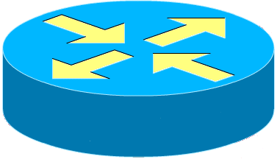
VLSM Design exercise
196.123.23.0
N.N.N. x x x x x x x x
N.N.N.12 /30
N.N.N. x x x x x x h h
N.N.N.4 /30
26
N.N.N. 0 0 0 0 0 1 h h
N.N.N.8 /30
N.N.N. 0 0 0 0 1 0 h h
N.N.N. 0 0 0 0 1 1 h h
10
12
Serial Links
60
N.N.N. 0 0 0 1 0 0 h h
N.N.N.16 /30
N.N.N. 0 0 0 1 0 1 h h
N.N.N. 0 0 0 1 1 0 h h
19
N.N.N. 0 0 0 1 h h h h
IP: 196.123.23.0
Notes:
There are two methods for designing VLSM networks. Top down and bottom up.
In the top down method the design goes very much like dividing a Pie. The whole Pie is the total number of addresses of the addressing scheme. Depending on the requirements you can divide the pie into slices (Let’s say 4) you now have a pie divided by 4, if your requirements change you can further divide the slices into smaller slices and allocate them. Let’s say you take a quarter and subdivide the quarter by 4 again, so that portion of the network would have a different subnet mask. Once again, if necessary, you could further subdivide the smaller portions of the network into even smaller ones, and so on.
In the diagram above we are taking the other approach (bottom up). We assume that there will be NO changes in the number of hosts in each subnet.
Note that by the conventional (classful) method we wouldn’t be able to allocate addresses to all subnets if we started with the Class C address proposed.
Method:
First we check how many bits can we use for subneting, in this case 8.
Second we are to check which subnets need the least amount of usable addresses. (Serial links that require 2 host addresses) and allocate the number of bits for the host portion required (2 bits = 2 host + Network + Broadcast addresses)
Now we assign the required subnets by working in the subnet portion of the addressing scheme. Creating the subnets:
196.123.23.4 / 30
196.123.23.8 / 30
196.123.23.12 / 30
196.123.23.16 / 30
196.123.23.20 / 30 Spare (Dashed ones)
196.123.23.24 / 30 Spare (Dashed ones)
Fourth, we will check what are the subnets that are next in line of the size, (10 & 12) which will need 4 bits.
Fifth, we draw the new line dividing Subnet and Hosts areas.
Sixth, verify if there are any bits already in use, in this case the fifth bit was already used in previous addresses, move to the next binary boundary (N.N.N.32/28) and continue as per described before, allocating the number of subnets needed for this size.
Repeat operation until all the networks are fulfilled.

Slide 14
VLSM Design exercise cont.
196.123.23.0
N.N.N. x x x x x x x x
N.N.N.12 /30
N.N.N. 0 0 0 1 h h h h
<< Already in Use
N.N.N.4 /30
N.N.N.96 /27
26
N.N.N. 0 0 1 0 h h h h
N.N.N.8 /30
N.N.N. 0 0 1 1 h h h h
N.N.N. 0 0 1 h h h h h
<< Already in Use
10
12
60
N.N.N. 0 1 0 h h h h h
N.N.N.32 /28
N.N.N.48 /28
N.N.N.16 /30
N.N.N. 0 1 1 h h h h h
N.N.N.128 /26
N.N.N. 0 1 h h h h h h
<< Already in Use
N.N.N.64 /27
19
N.N.N. 1 0 h h h h h h
IP: 196.123.23.0
Notes:
In this slide we are only finishing the diagram and allocation of addresses. Notice how with a single “Class C” address we were capable of allocating addresses to all subnet in this design.

Slide 15
Route Summarization
Also called route Aggregation or Supernetting
Advantages:
  Reduction of the number of Routing Table entries.
  May be used to isolate Topological changes

Slide 16
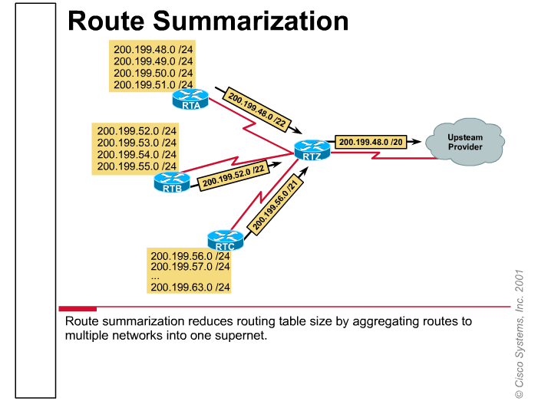
Example:

Slide 17
Working it out.
200.199.48.0 /24
200.199.49.0 /24
200.199.50.0 /24
200.199.51.0 /24
200.199.00110000.hhhhhhhh
200.199.00110000.hhhhhhhh
200.199.00110001.hhhhhhhh
200.199.00110010.hhhhhhhh
200.199.00110011.hhhhhhhh
255.255.11111100.00000000
Summarized Address 200.199.48.0 / 22

Slide 18

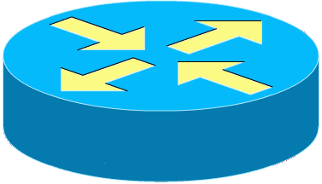
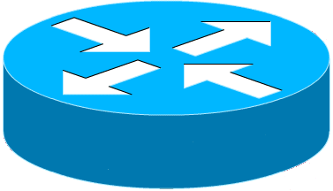
Problems when Summarizing routes.
172.16.5.0/24
172.16.6.0/24
172.16.1.0/24
172.16.2.0/24
B
A
C
EIGRP Advertises 172.16.0.0/16
EIGRP Advertises 172.16.0.0/16
  EIGRP on both Router A and Router C advertise a summarized route to 172.16.0.0/16
  Router B receives two routes to 172.16.0.0/16
  Router A & B should be configured with:
  router(config-router)# no auto-summary

Slide 19

Don’t forget to complete the evaluation Form
Thank YOU!
Prepared by:
J. Straube

Slide 20

Prepared by:
J. Straube

Slide 21


Presentation_ID
© 2001, Cisco Systems, Inc. All rights reserved.

